Slide 1
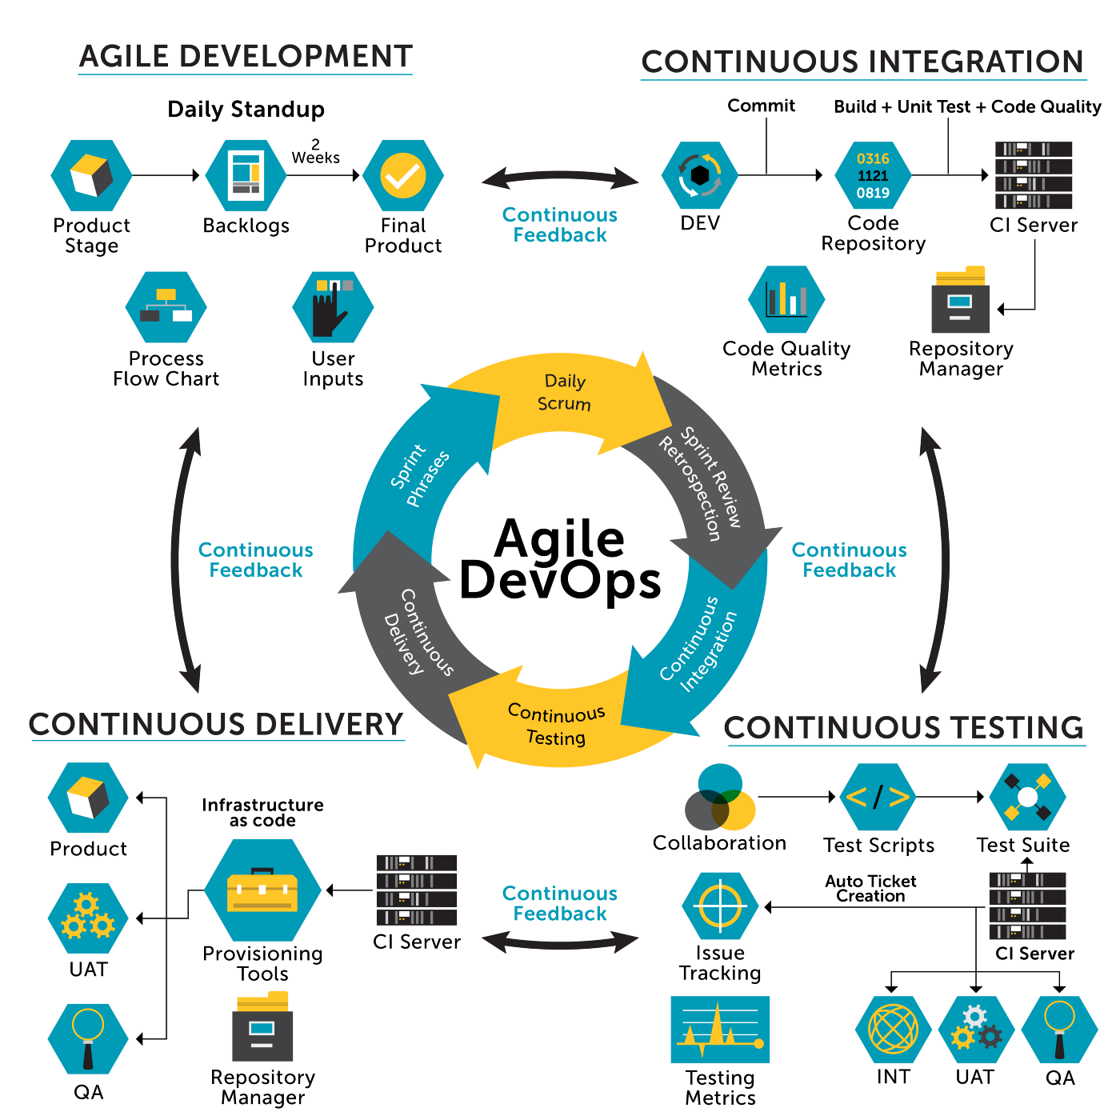
Introduction to DevOps
DevOps is a software development approach that combines development (Dev) with IT operations (Ops).
It is a culture to promote the development and operation process collectively.
It aims to shorten the systems development life cycle and deliver high-quality software.
- Bhakti Menkar
Batch: 2023-10427
Enrollment No: EBEON0923756263

Slide 2
What is DevOps?
Collaboration & Integration
Automation & Tooling
DevOps is a culture and practice emphasizing collaboration and integration between software developers and IT operations teams.
It involves the use of automation and specialized tools to streamline the software development and delivery process.
Continuous Delivery
Reduces Disconnection
DevOps aims for continuous delivery, where code changes are released to production frequently and reliably.
DevOps helps you to reduce the disconnection between software developers, QA engineers, and system administrators.

Slide 3


Why DevOps?
The operation and development team worked in complete isolation.
Team members are spending a large amount of time on designing, testing, and deploying instead of building the project.
Manual code deployment leads to human errors in production.
Coding and operation teams have their separate timelines and are not in sync, causing further delays.
Fosters a culture of innovation as teams are empowered to experiment and release new features quickly.
Software can be delivered faster and more frequently, with improved quality due to increased focus on testing and feedback.
Automation reduces manual work and errors, leading to cost savings.
Improved collaboration and a shared sense of ownership boost team morale and motivation.

Slide 4
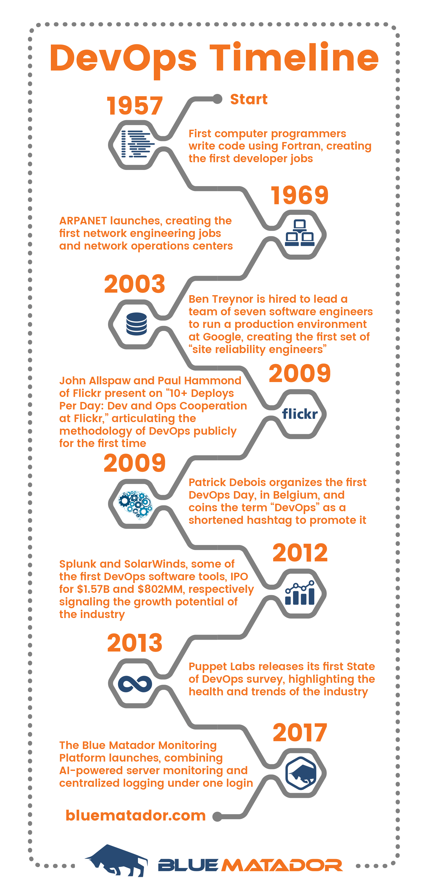

History
1
Early Beginnings
DevOps can trace its roots back to the Agile Manifesto in the early 2000s. It emerged as a response to the traditional siloed approach to software development and IT operations.
2
Collaborative Practices
In 2009, the concept of DevOps gained traction with the "10 Deploys Per Day" presentation by John Allspaw and Paul Hammond, showcasing the benefits of collaboration between development and operations teams.
3
Growth and Evolution
As organizations recognized the need for speed, efficiency, and innovation, DevOps principles continued to evolve, leading to the establishment of best practices and a cultural shift in the industry.

Slide 5
DevOps Architecture Features
Automation
Collaboration
Integration
Configuration Management
Reduce time consumption
The productivity increases
Releases are made quicker
Catching bugs quickly so that it can be fixed easily.
Improves the cultural model
Teams become more productive
Shared responsibilities and work closely in sync, which in turn makes the deployment to production faster.
continuous integration and delivery are implemented to deliver in a quicker, safer, and reliable manner.
There are significant operational challenges while integration and testing
Application interacts with only those resources that are concerned with environment in which it runs.
The configuration file can be written during deployment, or they can be loaded at the run time, depending on the environment in which it is running.

Slide 6
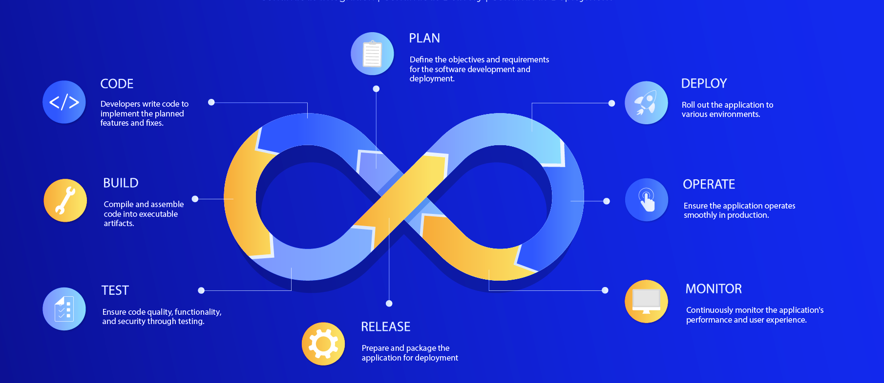
DevOps Architecture

Slide 7
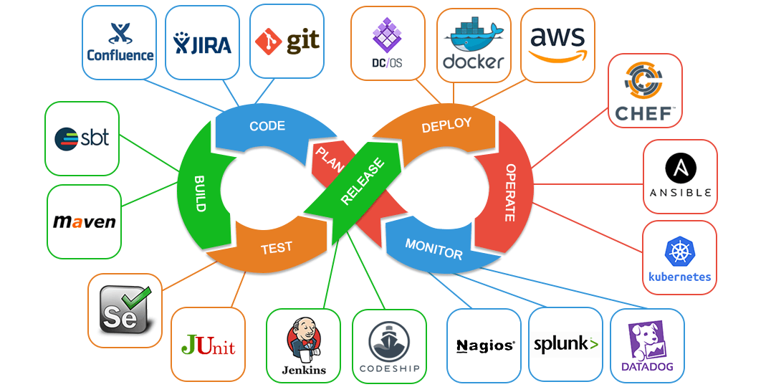
DevOps Tools and Technologies
DevOps tools and technologies encompass a wide range of software, platforms, and infrastructure-as-code solutions designed to streamline software development, testing, deployment, and monitoring. These tools enable automation, collaboration, and the implementation of DevOps practices, fostering faster delivery, improved quality, and more efficient operations across the entire development lifecycle.

Slide 8
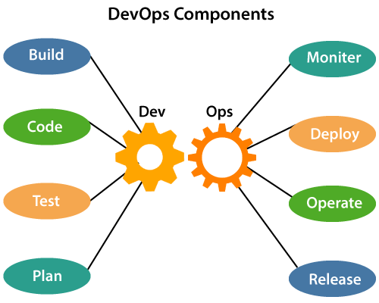
DevOps Components
Compile and assemble code into executable artifacts
Continuously monitor the application’s performance and user experience
Developers write code to implement the planes features and fixes
Roll out the application to various environments
Insure code quality, security and functionality through testing
Ensure that the application performs smoothly in production
Define the requirements and objectives for software development and deployment
Prepare and package the application for deployment

Slide 9

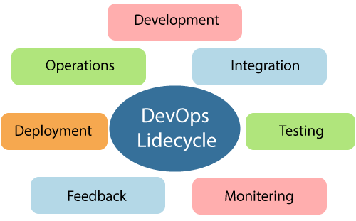
DevOps Lifecycle
Planning and coding of the software
Vision of the project is decided
No DevOps tool required for planning, but required for maintaining the code
Based on the continuity with complete automation
Critical factor in DevOps
More efficient software product
Heart of the lifecycle
Frequent commits to the source code
Daily or weekly basis
Allows early detection of problems if any
Code is deployed to production server
Ensures that the code is correctly used on all servers
Vagrant and Docker are popular tools that are used in the process
Continuous testing for bugs
Automation testing tools such as TestNG, JUnit, Selenium etc are used.
No flaw in functionality is ensured
Constant feedback about the next versions between operations and development
Analysis for software working results
Application development consistently improved
Involves all operational factors of process
Important information about the use of software is recorded
It is integrated within the operational capabilities of software

Slide 10
Advantages
1
Excellent Approach
2
Enhanced Quality Decreased Costs
Faster response to market changes and improves business growth
Decreased failure rate, delivery and transportation costs of new releases and faster resolution of issues.
3
Collaborative Work Environment
4
Profit Growth
Enhanced collaboration and communication between development and operations teams.
Clarity in product development and delivery results into escalated business profits

Slide 11
Disadvantages
1
Talent Gap
2
Expensive Approach
DevOps professional or expert's developers are less available.
Developing with DevOps is so expensive.
3
Difficult to Manage
4
Lack of knowledge
Adopting new DevOps technology into the industries is hard to manage in short time.
Lack of DevOps knowledge can be a problem in the continuous integration of automation projects.

